Slide 1
VIEWING TRANSFORMTION & CLIPPING

Slide 2
Window and Viewport mapping
Point Clipping
Line Clipping
Cohen-Sudhenland
Parametric
Polygon Clipping

Slide 3
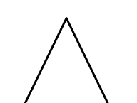
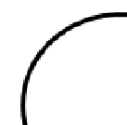
Y
Device screen
X
World coordinate
Device screen

Slide 4
World coordinate
Cartesian coordinate w.r.t which we define diagram
Window
An area on world coordinate selected for display.
Device Coordinate
Screen Coordinate
Viewport
Area on device coordinate where graphics is to be displayed
The coordinate system of the frame buffer.
Viewing transformation
Window to viewport mapping

Slide 5
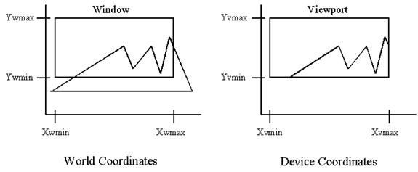

Slide 6
VIEWING TRANSFORMATION BY NORMALIZATION
(x_{w}, y_{w}) : A point on window
(x_{v}, y_{v}) : Corr. point on viewport
Normalized point on window
Normalized point on viewport

Slide 9
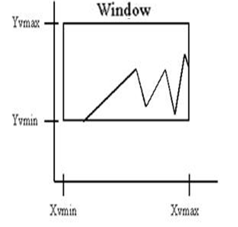
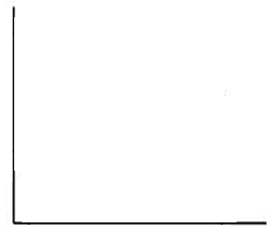
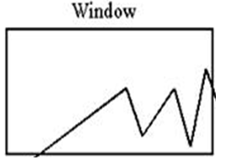

VIEWING TRANSFORMATION BY COMPOSITE TRANSFORMATION
(x_{w}, y_{w}) : A point on window
(x_{v}, y_{v}) : Corr. point on viewport

Slide 12
CLIPPING OPERATION
Clip window
Interior clipping
Exterior clipping

Slide 13
POINT CLIPPING
Y_{Max}
Plot a point (x, y)
Y_{Min}
X_{Min}
X_{Max}

Slide 14
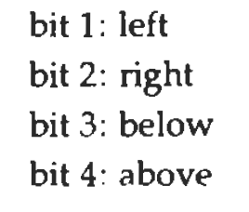
Cohen-Sutherland LINE CLIPPING algorithm
1001
1000
1010
0001
0000
0010
0101
0100
0100

Slide 15
P2
P2’
1000
1001
1010
P2’’
0001
0000
0010
P1’
0101
0100
P1
0110

Slide 16
Liang-Barsky Line Clipping
(X_{end} ,Y_{end})
Y_{Max}
Y_{Min}
(X₀ ,Y₀)
X_{Min}
X_{Max}
Parametric definition of a line:
x = x₀ + u∆x
y = y₀ + u∆y
∆x = (x_{end} – x₀), ∆y = (y_{end} – y₀), 0 ≤ u ≤ 1

Slide 17
From point clipping strategy
xmin ≤ x0 + u∆x ≤ xmax
ymin ≤ y0 + u∆y ≤ ymax
-u∆x ≤ (x0 - xmin)
u∆x ≤ (xmax – x0)
-u∆y ≤ (y0 - ymin)
u∆y ≤ (ymax – y0)

Slide 18
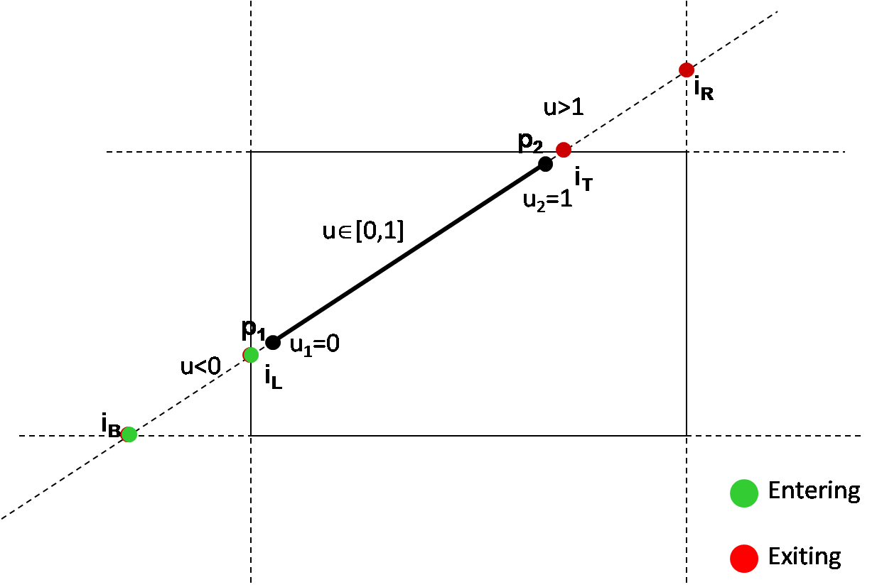
u pk ≤ qk
Line is parallel to clipping window
Line is exiting
Line is entering
Min(Exiting u,1)
Max(Entering u,0)

Slide 19
ALGORITHM
Initialize U_{min}=0 and U_{max}=1
Calculate ‘u’ values (eg. u_{left} ,u_{right} ,u_{top} ,u_{bottom})
If u<U_{min} or u>U_{max} ignore it.
Otherwise update U_{min} and U_{max}
If U_{min} < U_{max}
Draw a line between the following points
1. (x₀+ U_{min} ∆x, y₀+ U_{min} ∆y)
2. (x₀+ U_{max} ∆x, y₀+ U_{max} ∆y)
Otherwise if U_{min >} U_{max}
No line segment to draw.

Slide 20
POLYGON CLIPPING

Slide 21
Cohen-Hodgeman POLYGON CLIPPING algorithm
v2
v2
v1’
v1
v1
SAVE v1’and v2
SAVE NOTHING
v2
v2
v1’
v1
v1
SAVE v2
SAVE v1’

Slide 22
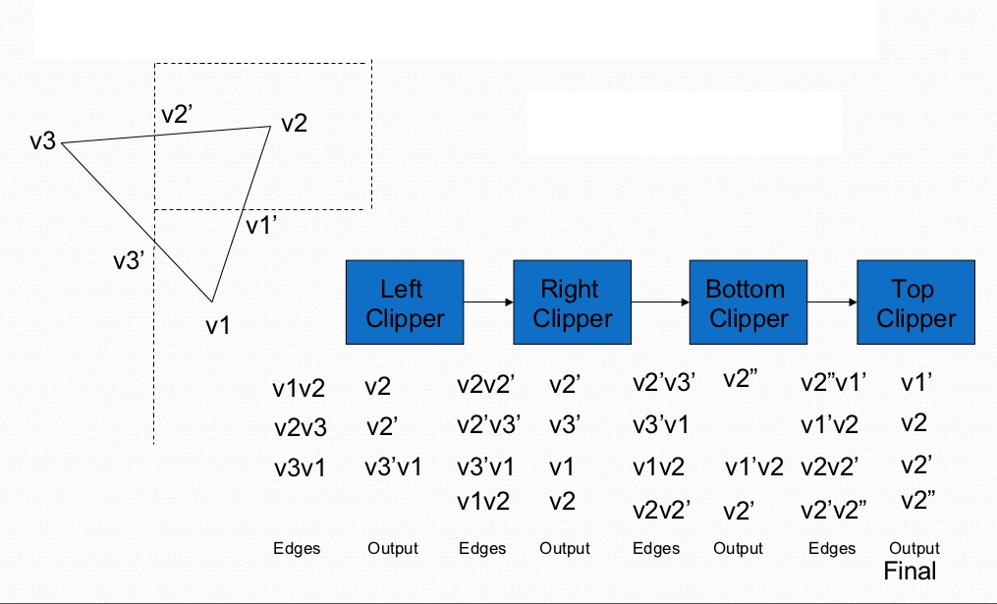
v2’’

Slide 23
END OF CHAPTER

